Slide 1
Chapter Seven
Architecture in Advance

Slide 2
Cloud Definition
The cloud is Internet-based computing, whereby shared resources, software, and information are provided to computers and other devices on demand
pay per use.
Cost-effective means of vitalizing and making use of resources more effectively
Low start-up costs – pay for use helps to kick-start companies
Scaling is proportional to demand (revenue) so it’s a good business model
Vast range of Cloud Computing applications
Virtual private servers, Web hosting, data servers, etc

Slide 3
Cloud Computing
Cloud computing is a model for enabling on-demand access to shared pool of compute resources e.g. server, application & service.
In other words, cloud computing is a model for delivering IT services. Instead of a direct connection to the server, the resources are retrieved from the Internet though web-based tools and applications.
Data and software packages are stored in servers. The cloud computing structure allows access to information as long as an electronic device has access to the web. This allows employees to work remotely.

Slide 4
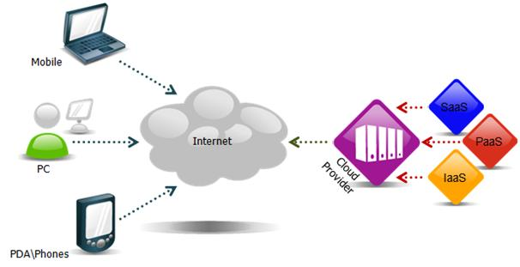
Cloud Computing
The name cloud computing was inspired by the cloud symbol that is often used to represent the Internet in flowcharts and diagrams.

Slide 5
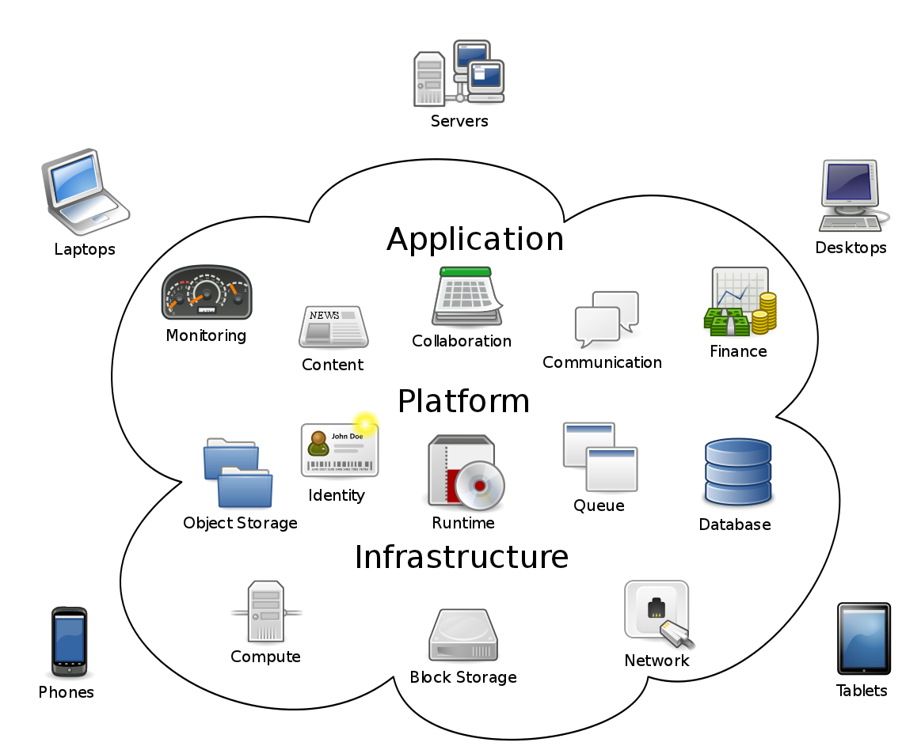
Cloud Computing Overview

Slide 6
Characteristics of Cloud Computing
Shared / pooled resources
Resources are drawn from a common pool
Common resources build economies of scale
Common infrastructure runs at high efficiency
Broad network access
Open standards and APIs
Almost always IP, HTTP, and WAP
Available from anywhere with an internet connection
On-demand self-service
Completely automated
Users abstracted from the implementation
Near real-time delivery (seconds or minutes)
Services accessed through a self-serve web interface
Scalable and elastic
Resources dynamically-allocated between users
Additional resources dynamically-released when needed
Fully automated
Metered by use
Services are metered, like a utility
Users pay only for services used
Services can be cancelled at any time

Slide 7
Service Delivery Models of cloud computing

Slide 8
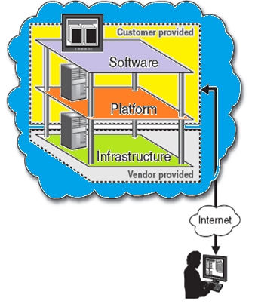
Service Delivery Models
Infrastructure-as-a-Service (IaaS)
A service model that involves outsourcing the basic infrastructure used to support operations--including storage, hardware, servers, and networking components.
The service provider owns the infrastructure equipment and is responsible for housing, running, and maintaining it. The customer typically pays on a per-use basis.
The customer uses their own platform (Windows, Unix), and applications

Slide 9
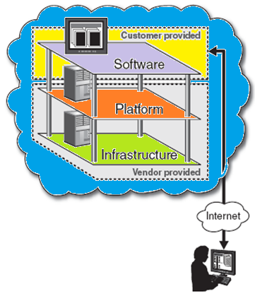
Service Delivery Models
Platform-as-a-Service (PaaS)
A service model that involves outsourcing the basic infrastructure and platform (Windows, Unix)
PaaS facilitates deploying applications without the cost and complexity of buying and managing the underlying hardware and software where the applications are hosted.
The customer uses their own applications

Slide 10
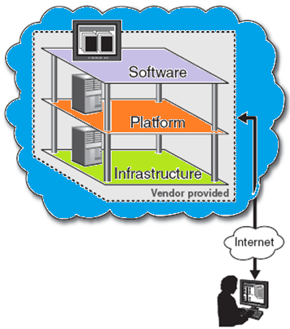
Service Delivery Models
Software-as-a-Service (SaaS)
Also referred to as “software on demand,” this service model involves outsourcing the infrastructure, platform, and software/applications.
Typically, these services are available to the customer for a fee, pay-as-you-go, or a no charge model.
The customer accesses the applications over the internet.

Slide 11
Cloud Computing Deployment Models
Public cloud
Public cloud (off-site and remote) describes cloud computing where resources are dynamically provisioned on an on-demand, self-service basis over the Internet, via web applications/web services, open API, from a third-party provider who bills on a utility computing basis.
Private cloud
A private cloud environment is often the first step for a corporation prior to adopting a public cloud initiative. Corporations have discovered the benefits of consolidating shared services on virtualized hardware deployed from a primary datacenter to serve local and remote users.
Hybrid cloud
A hybrid cloud environment consists of some portion of computing resources on-site (on premise) and off-site (public cloud). By integrating public cloud services, users can leverage cloud solutions for specific functions that are too costly to maintain on-premise such as virtual server disaster recovery, backups and test/development environments.
Community cloud
A community cloud is formed when several organizations with similar requirements share common infrastructure. Costs are spread over fewer users than a public cloud but more than a single tenant.

Slide 12
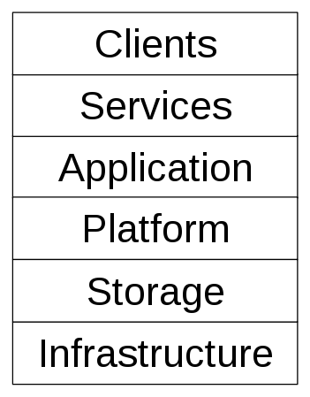
Basic Cloud Computing Components

Slide 13
Cloud Computing Components
Application
A cloud application leverages the Cloud in software architecture, often eliminating the need to install and run the application on the customer's own computer, thus alleviating the burden of software maintenance, ongoing operation, and support.
Client
A cloud client consists of computer hardware and/or computer software which relies on The Cloud for application delivery, or which is specifically designed for delivery of cloud services and which, in either case, is essentially useless without it.

Slide 14
Cloud Computing Components
Infrastructure
Cloud infrastructure, such as Infrastructure as a service, is the delivery of computer infrastructure, typically a platform virtualization environment, as a service.
For example:
Platform
A cloud platform, such as Platform as a service, the delivery of a computing platform, and/or solution stack as a service, facilitates deployment of applications without the cost and complexity of buying and managing the underlying hardware and software layers.

Slide 15
Cloud Computing Components
Service
A cloud service includes "products, services and solutions that are delivered and consumed in real-time over the Internet.
Storage
Cloud storage involves the delivery of data storage as a service, including database-like services, often billed on a utility computing basis, e.g., per gigabyte per month.

Slide 16
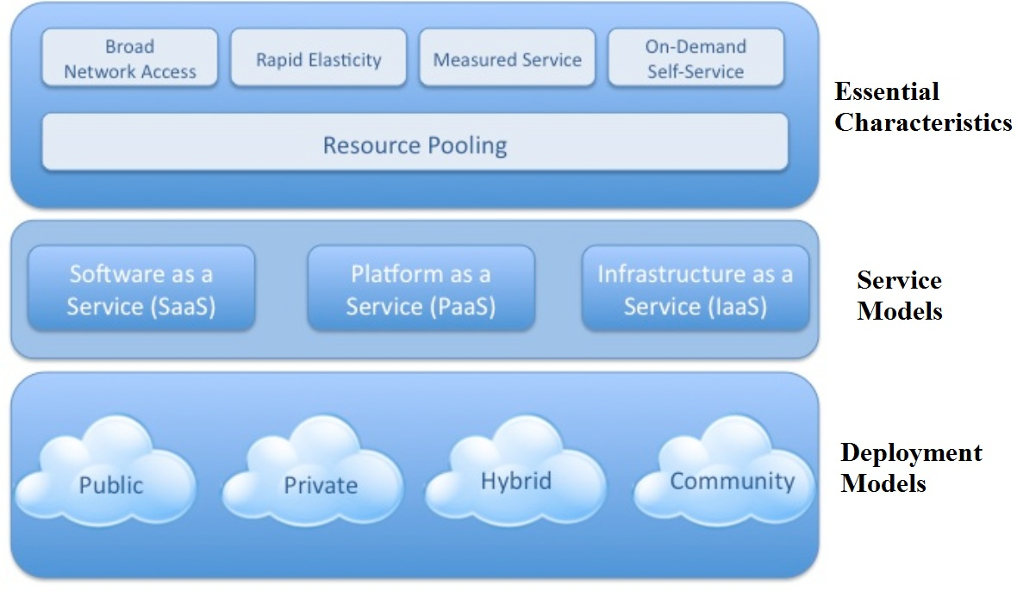
Architecture

